Slide 1
Israel
June 7-17, 2011

Slide 3
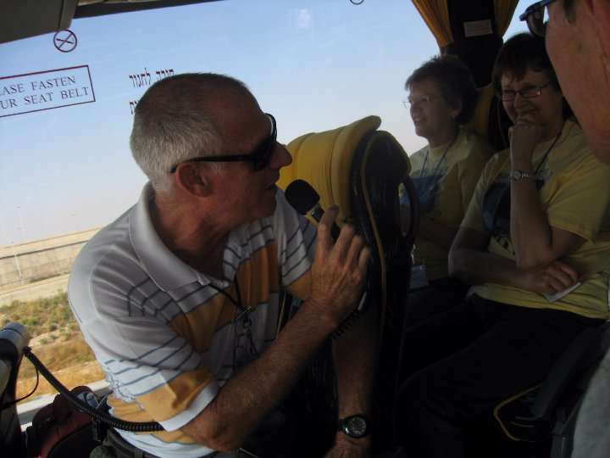
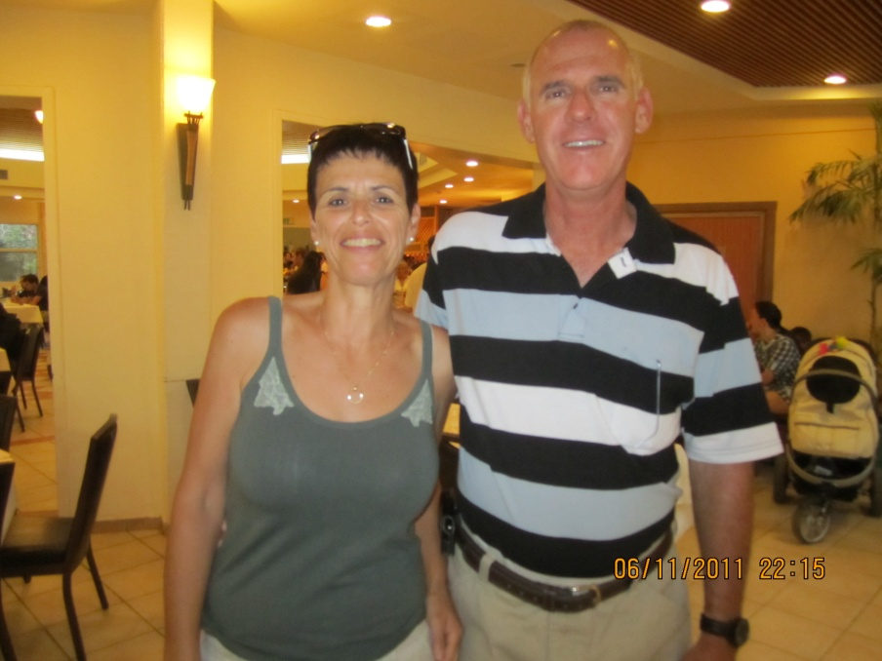
Our Israeli Guide
Ronny Simon

Slide 4
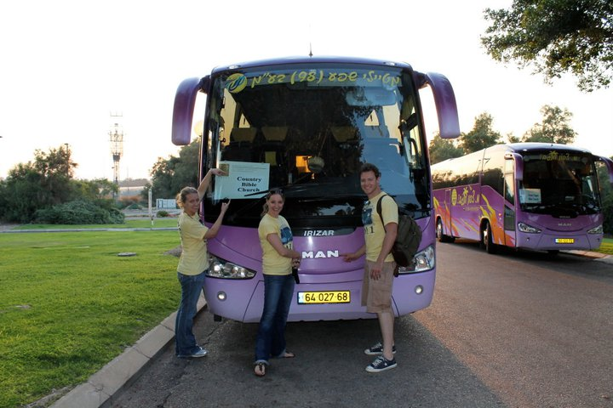
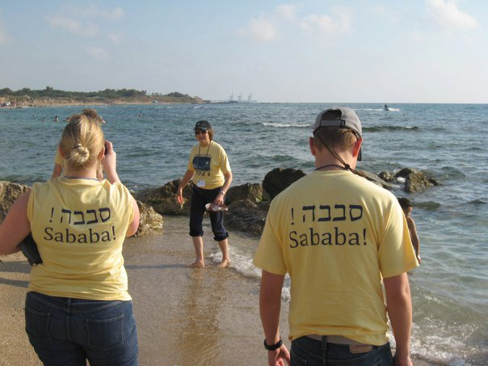
Arrival
Mediterranean Sea
Tel Aviv

Slide 5
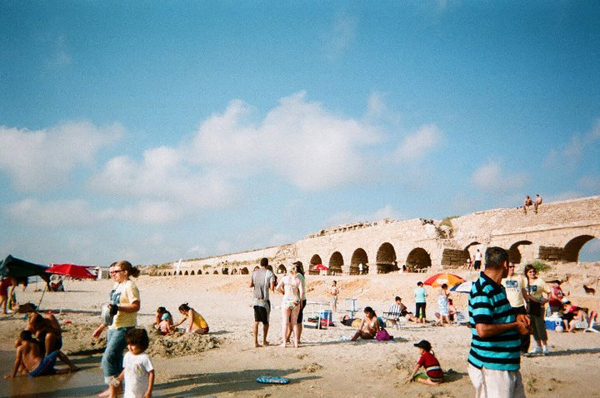
Day One
Caesarea
Roman Theater
Aqueducts

Slide 6
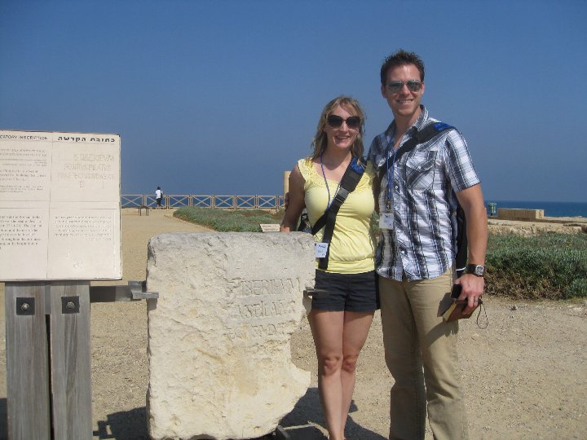
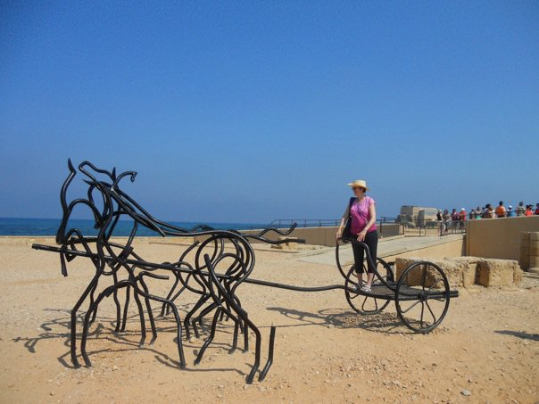
Caesarea
Herod’s Palace
Hippodrome

Slide 7
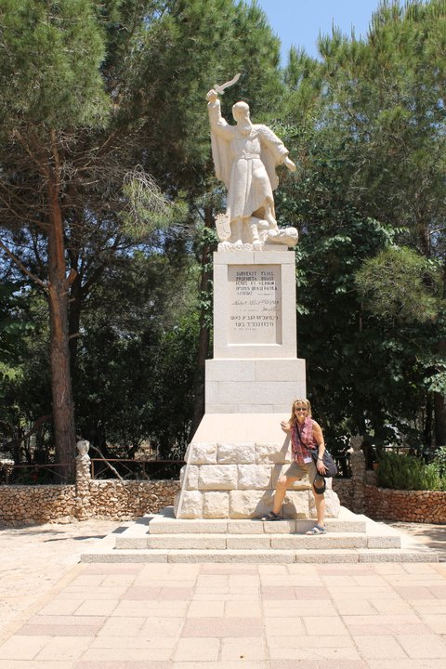
Mt. Carmel & the Valley of Megiddo

Slide 8
Mt. Arbel

Slide 9
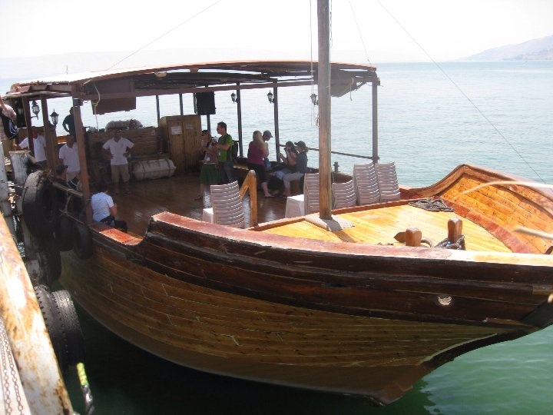
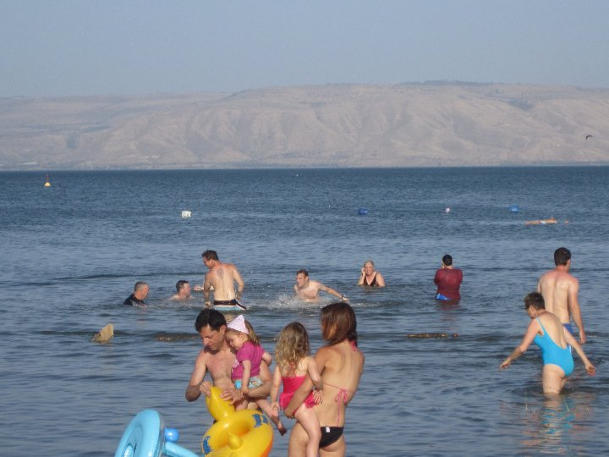
Day Two
Sea of Galilee

Slide 10
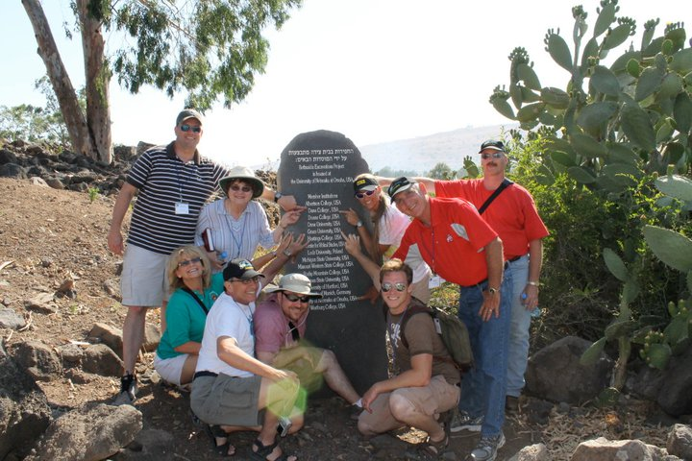
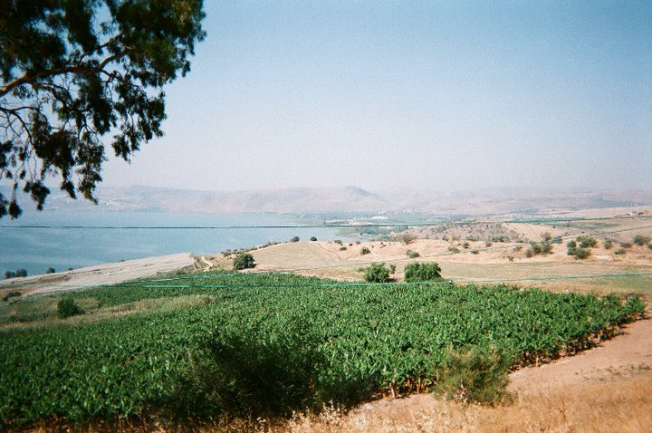
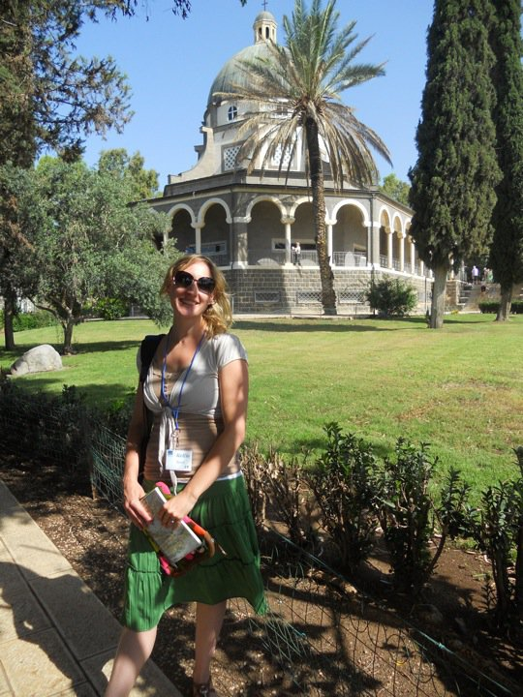
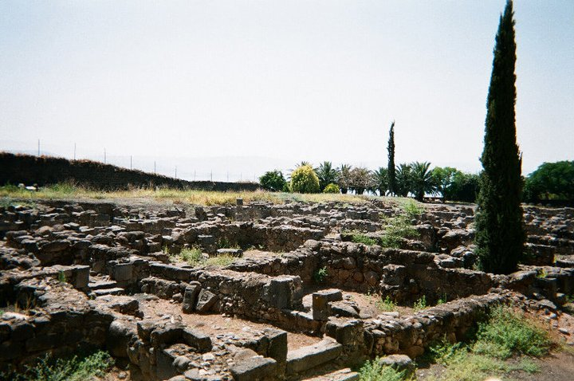
Bethsaida
Mt. of Beatitudes

Slide 11
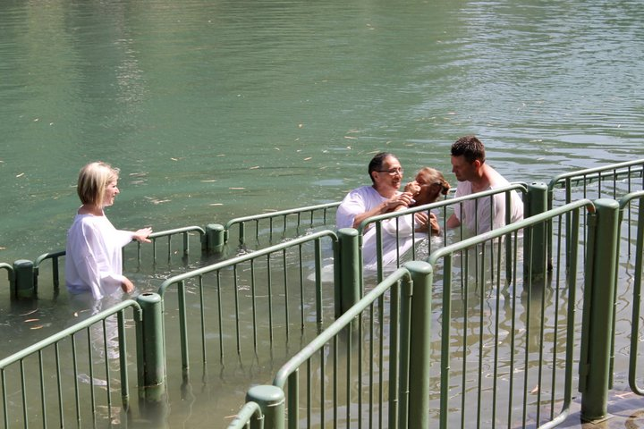
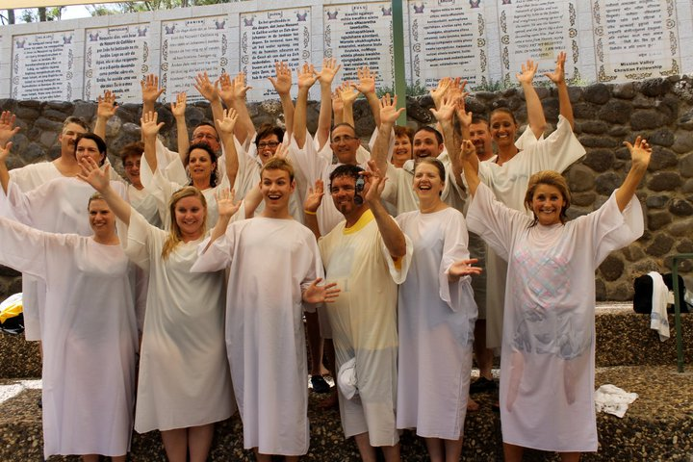
Jordan River

Slide 12
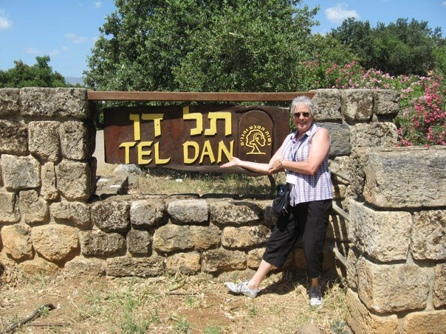
Day Three
Ancient city of Dan
Dan Nature Reserve

Slide 13
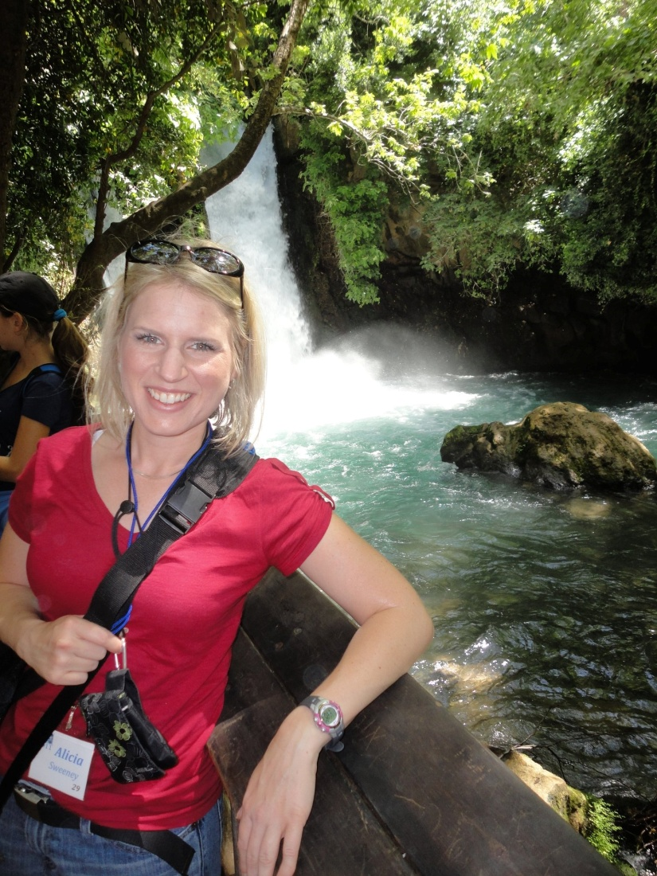
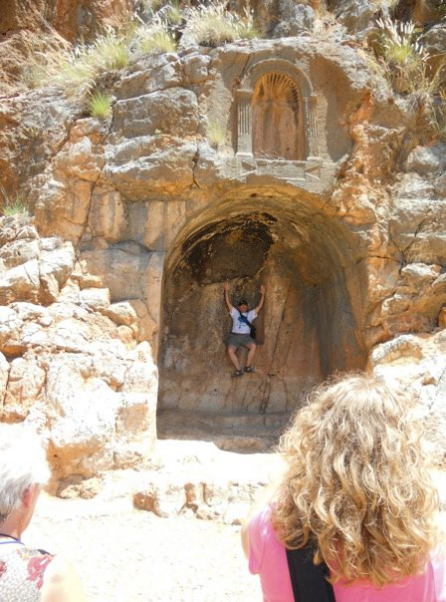
Banias Waterfall
Caesarea Philippi

Slide 14
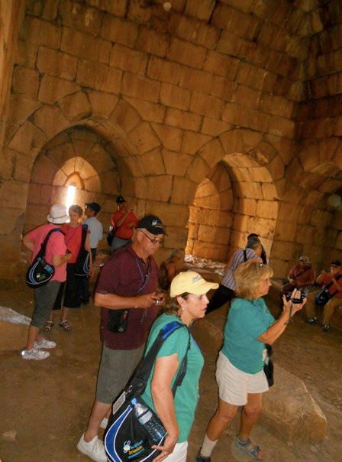
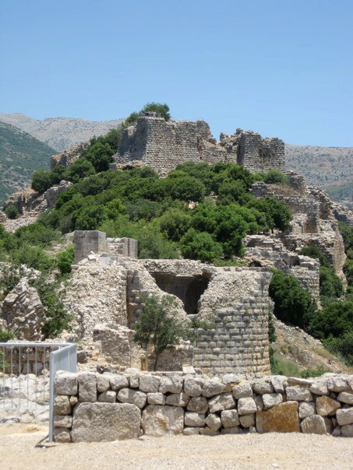
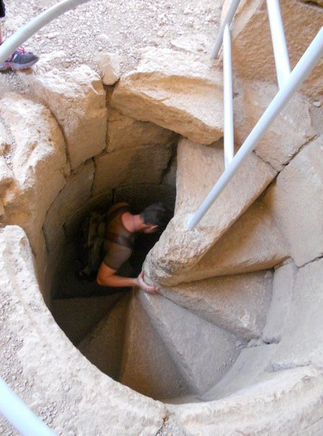
Nimrod’s Castle

Slide 15
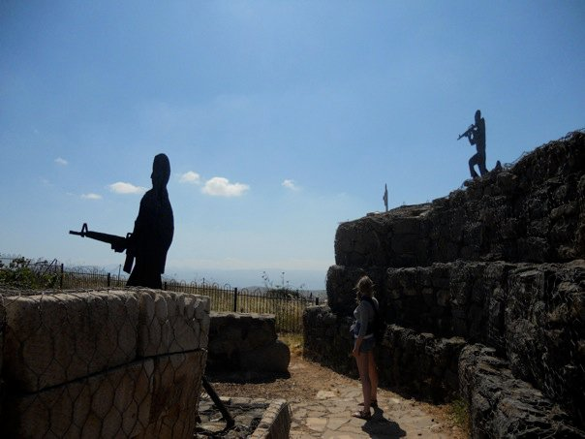
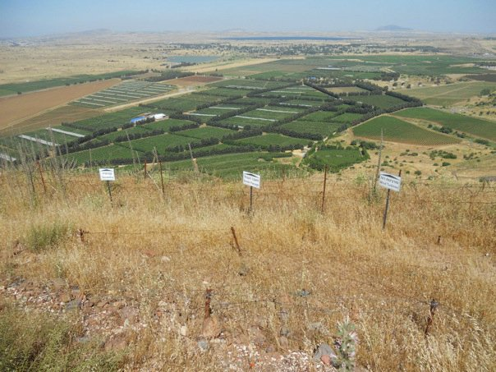
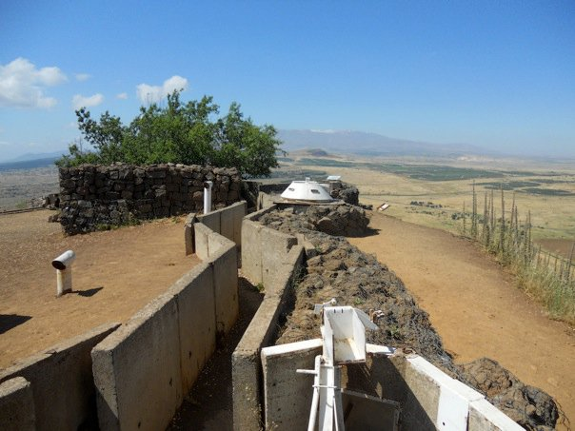
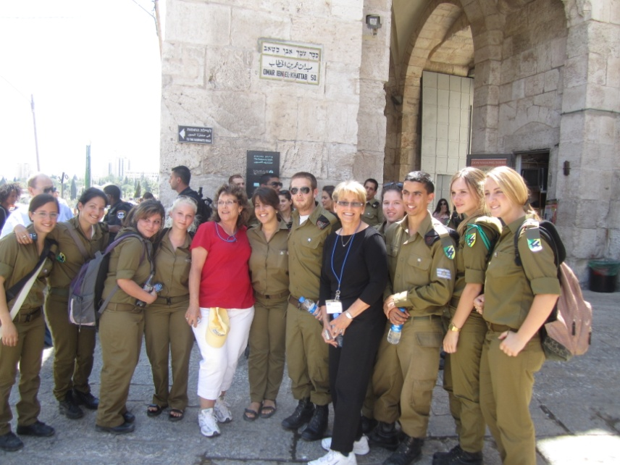
Golan Heights

Slide 16
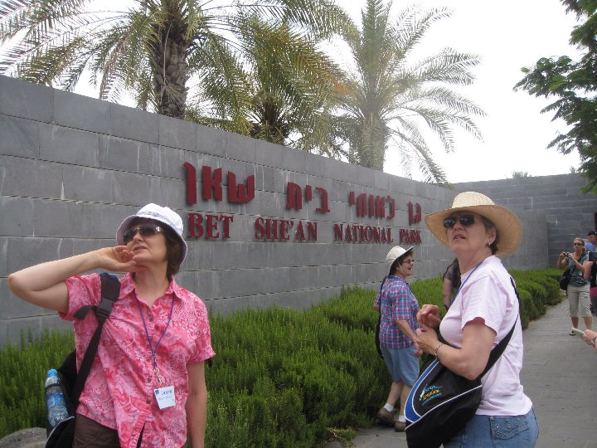
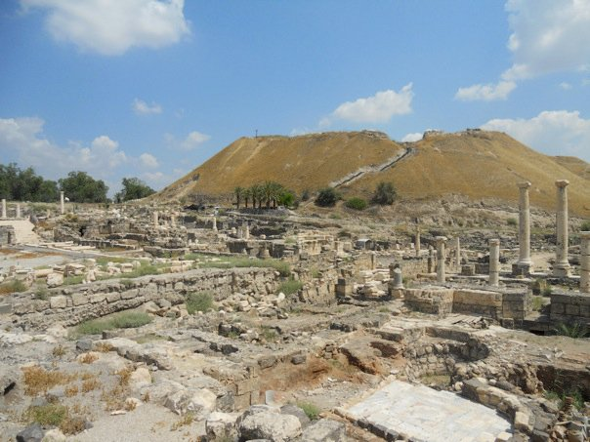
Day Four

Slide 17
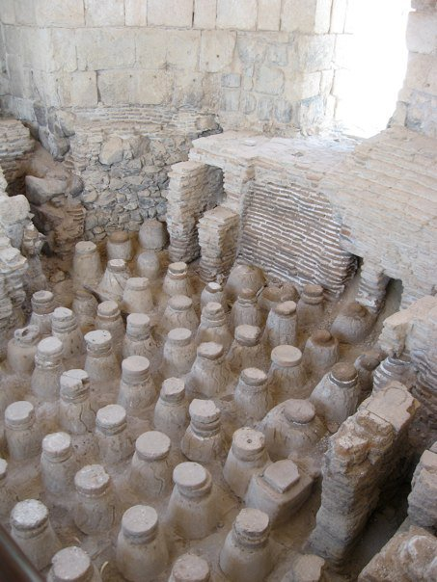
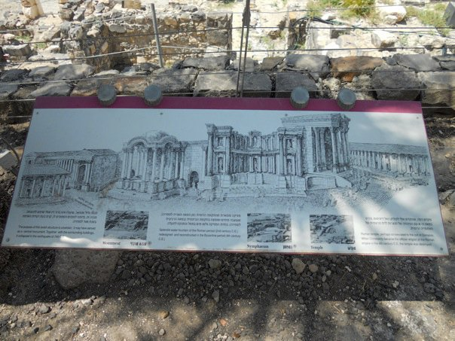
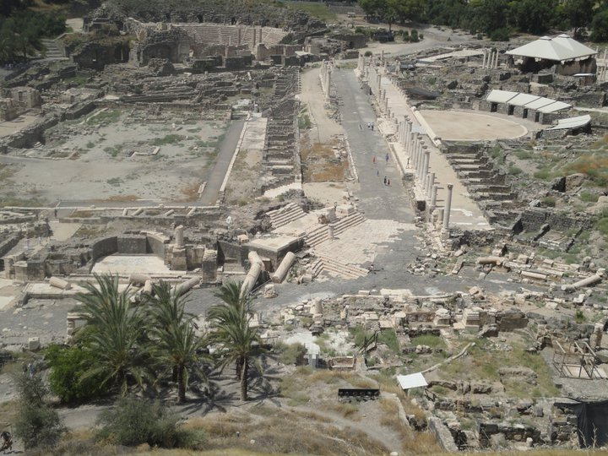
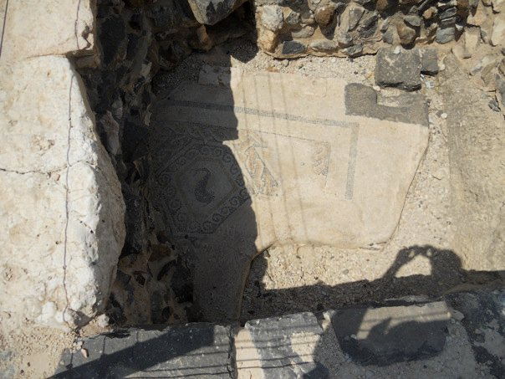
Bet She’an

Slide 18
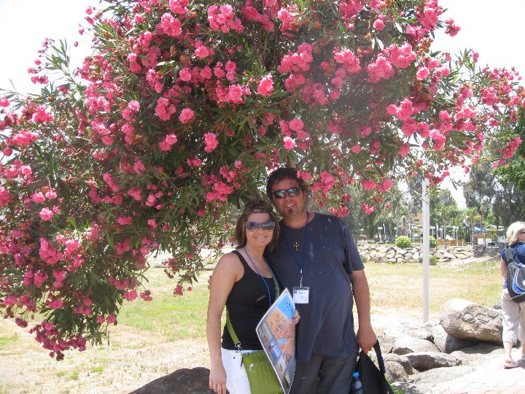
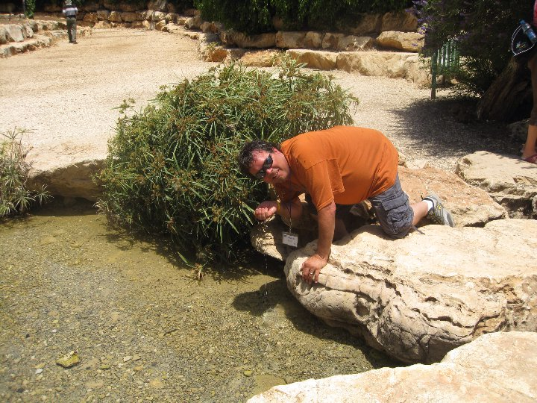
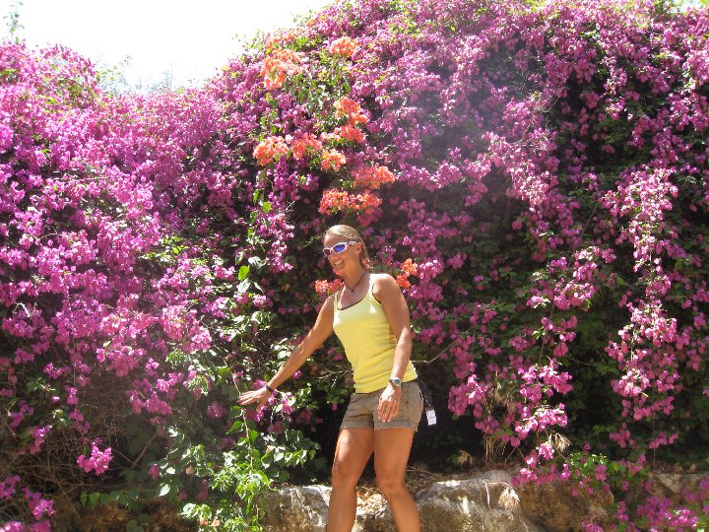
Spring of Herod/Gideon’s Spring

Slide 19
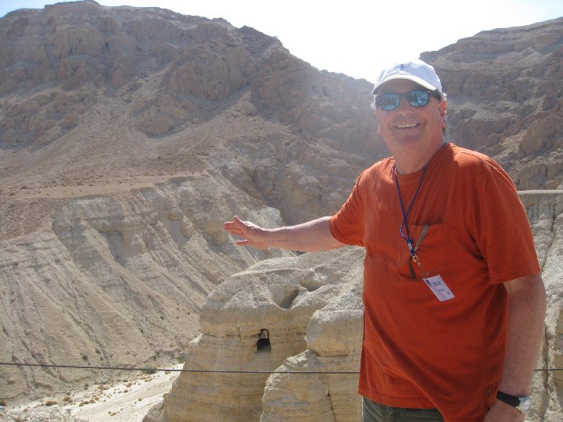
Qumran

Slide 20
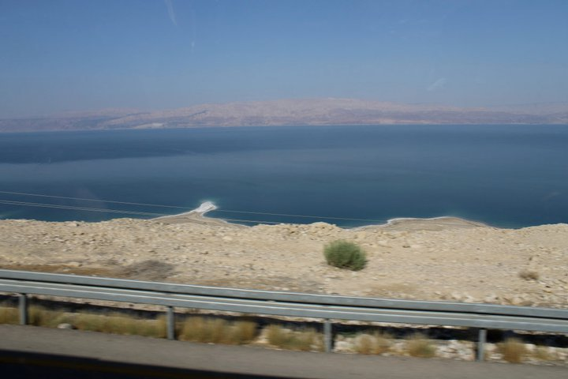
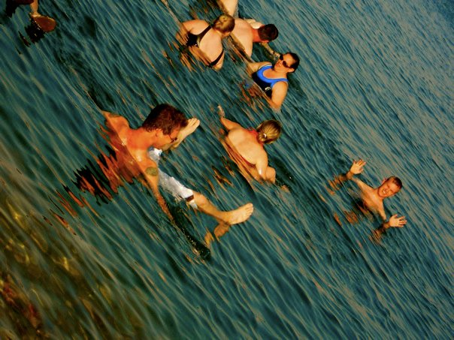
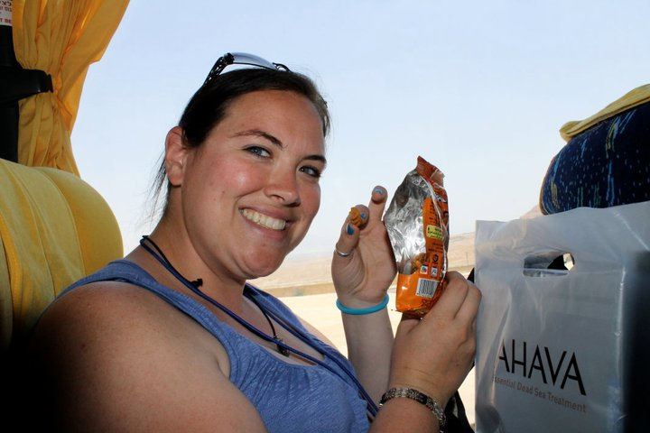
Dead Sea

Slide 21
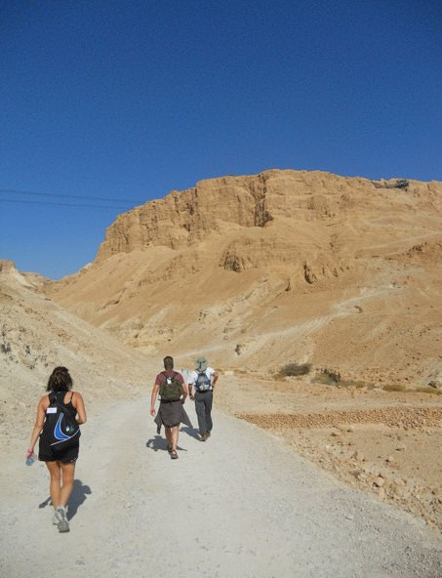
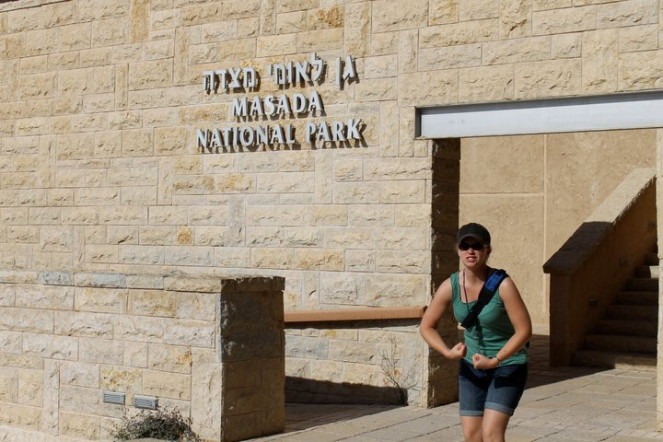
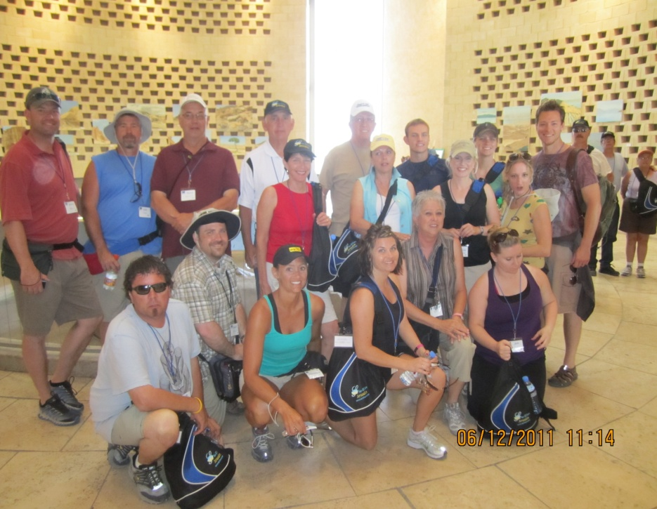
Day Five

Slide 22
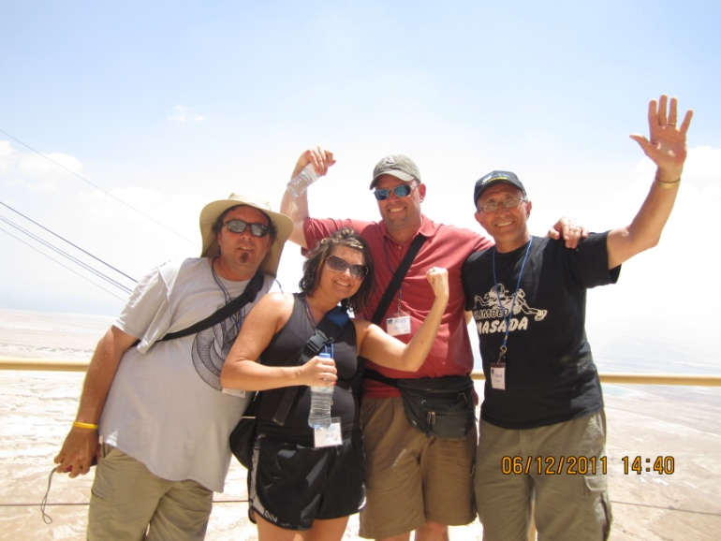
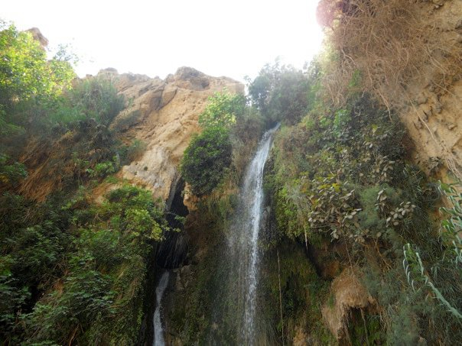
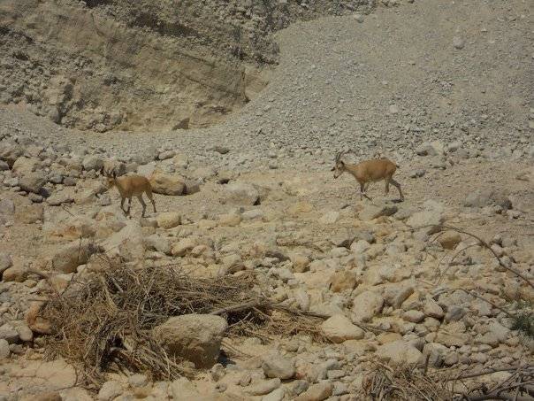
Oasis of Ein Gedi/David & Saul

Slide 23
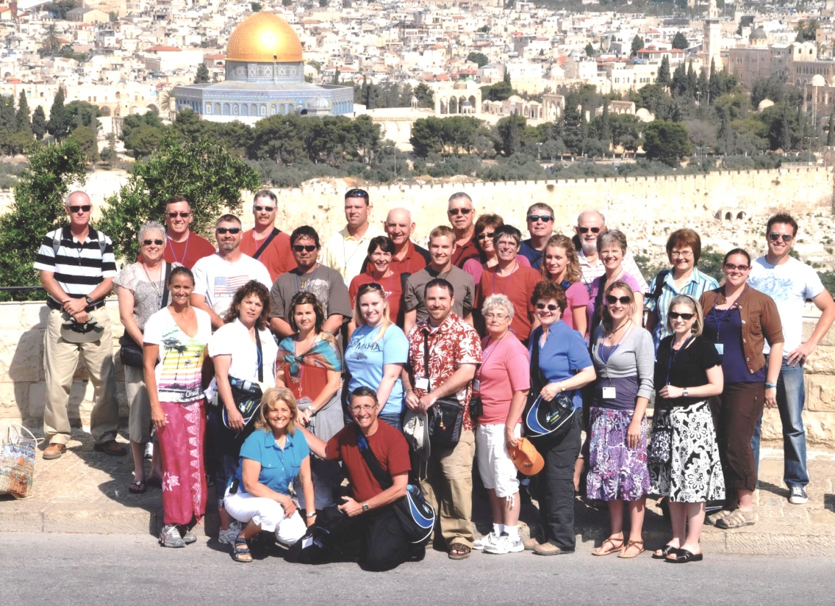
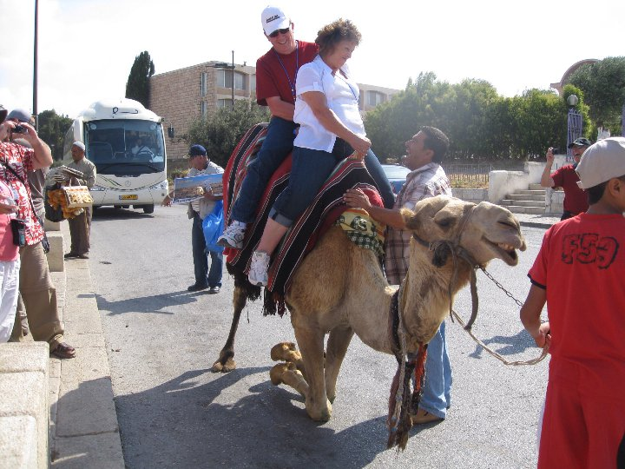
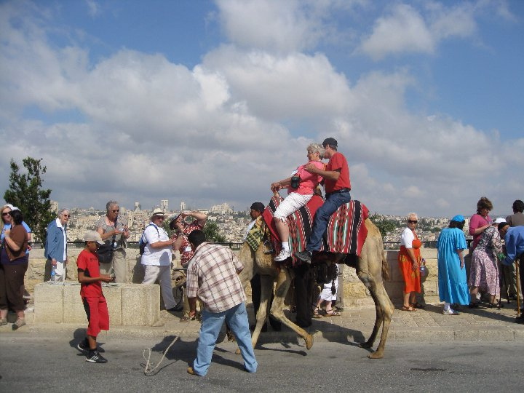
Day Six

Slide 24
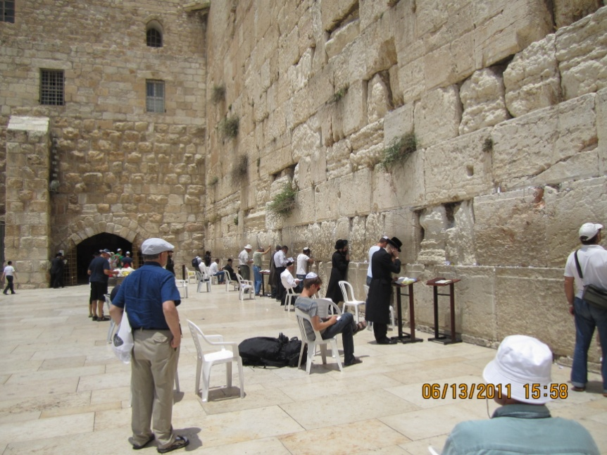
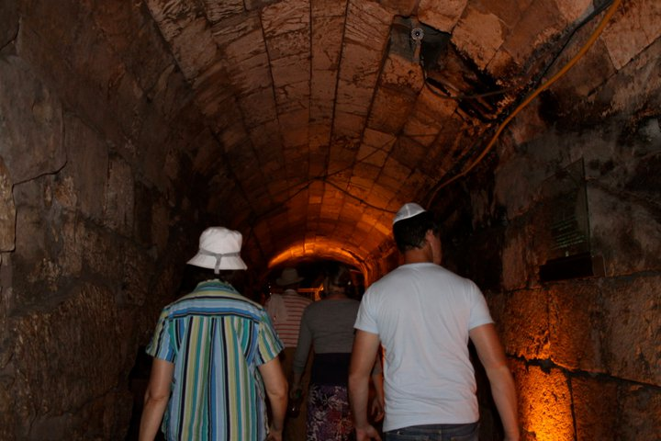
Western Wall
Rabbinical Tunnel

Slide 25
Bethlehem Overlook
Holocaust Museum
Model of Herodian Jerusalem

Slide 26
Day Seven
Valley of Elah
Beit Guvrin Archeological Dig

Slide 29
Southern Steps
City of David Excavations

Slide 30
Hezekiah’s Tunnel

Slide 32
Day Eight
Garden of Gethsemane
Dominus Flevit

Slide 33
Temple Mount

Slide 34
Pool of Bethesda
Saint Anne’s Church

Slide 35
Via Dolorosa
Upper Room

Slide 36
Gordon’s Calvary
Garden Tomb

Slide 37
The Empty Grave

Slide 38
Farewell Dinner
American Colony Hotel
Horatio Spafford. “It is well with my Soul”

Slide 39
Festival of Lights—Jerusalem

Slide 40
Find us on YouTube!

Slide 41
THANK YOU!
Ask us about the food, flowers, fun, fellowship!

